Slide 1
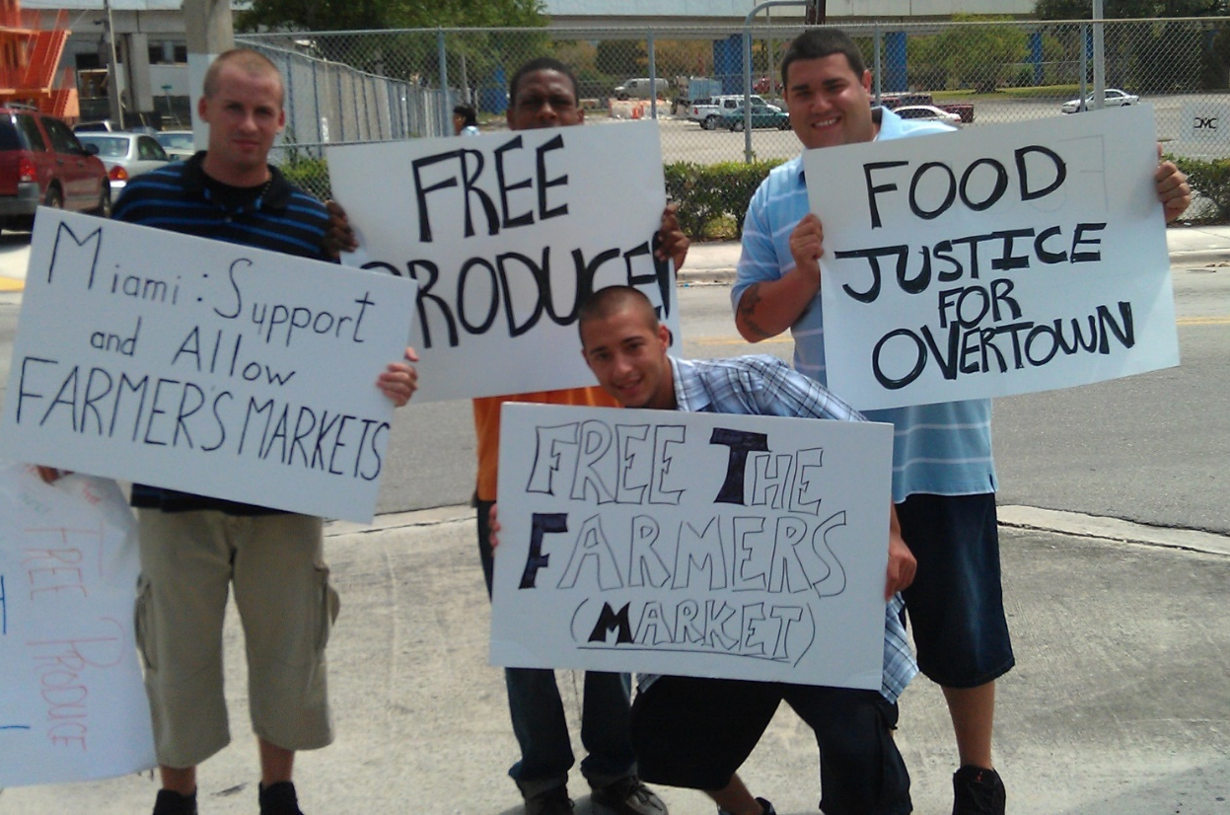
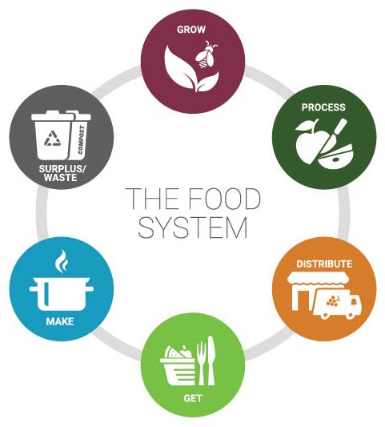
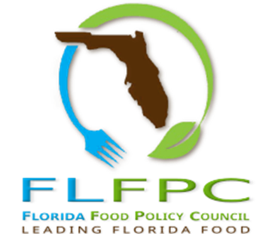
FOOD POLITICS:
THE ROLE OF POLICY IN THE FOOD SYSTEM
Anthony Olivieri, MURP
Board member, Florida Food Policy Council
Florida Food Forum, January 31st, 2020

Slide 2
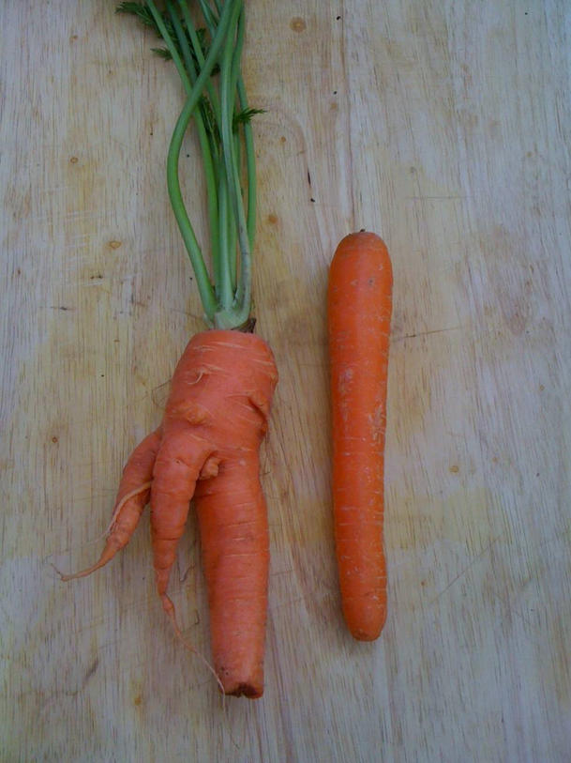
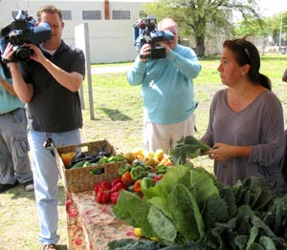
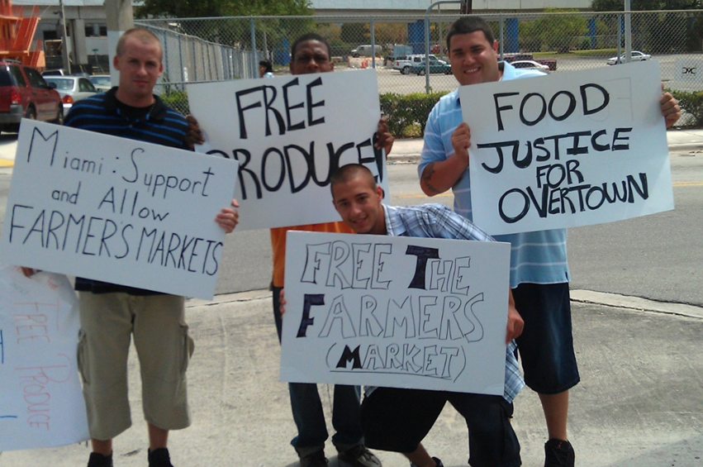
Roots in the City Overtown Urban Farm Closing, 2011
Maggi Pons, RITC market manager, and the media
Youth from Here’s Help assisting with the food give-away protest
“How we eat determines, to a considerable extent how the world is used.”
(Wedell Berry, 1990, p. 139)
Policies that shape the city,
to a considerable extent,
determine how we eat.
-Anthony Olivieri
Roots in the City Carrot Left, store Carrot, right
Notes:
Photos from the Roots in the City Market Closing Protest. https://redlandrambles.com/tag/roots-in-the-city
Community Organizing Around Food
Policies that shape the city, to a considerable extent, determines how we eat.

Slide 3

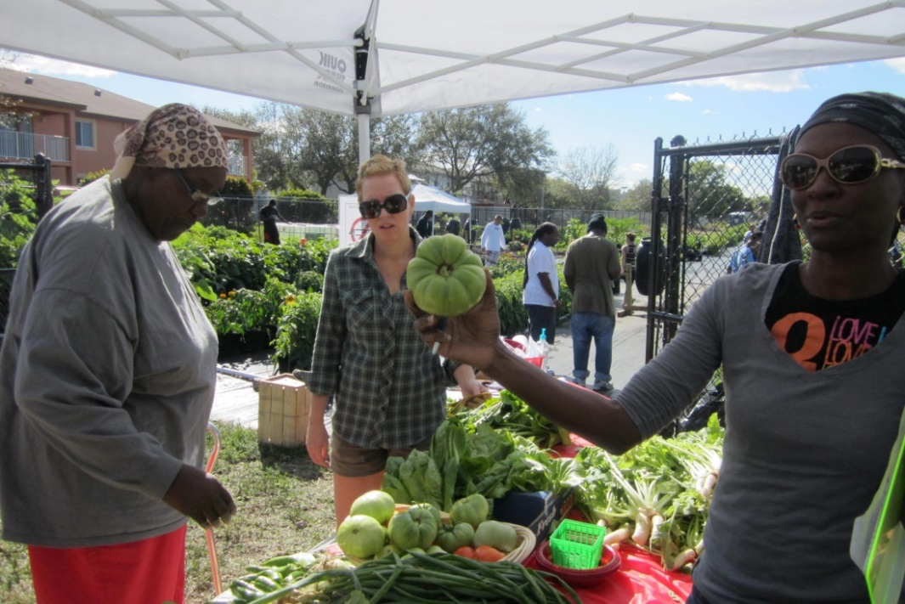
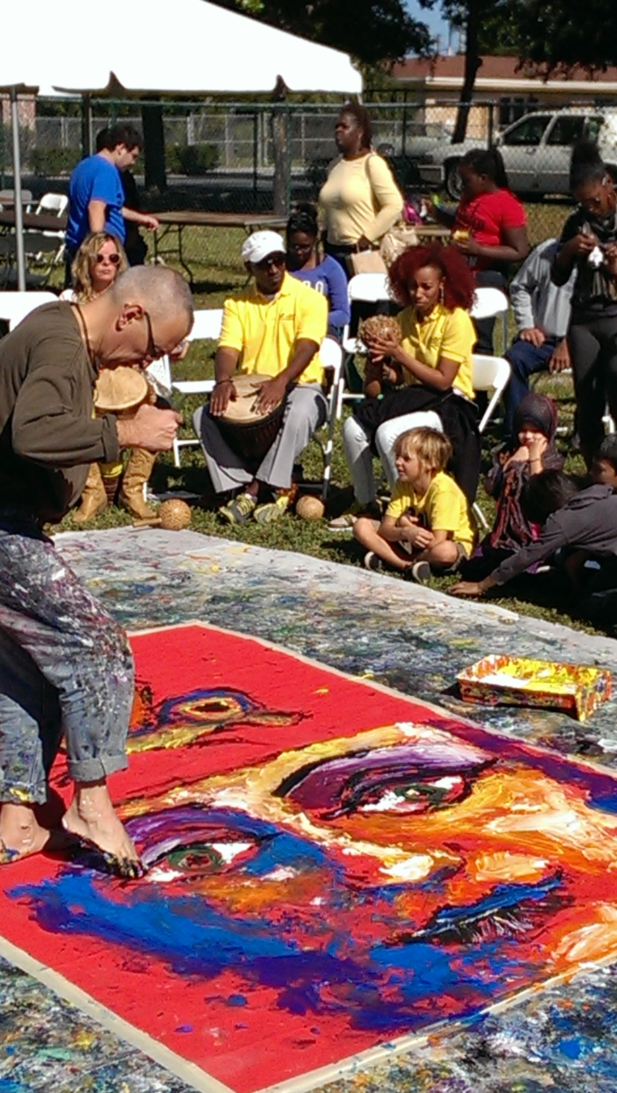
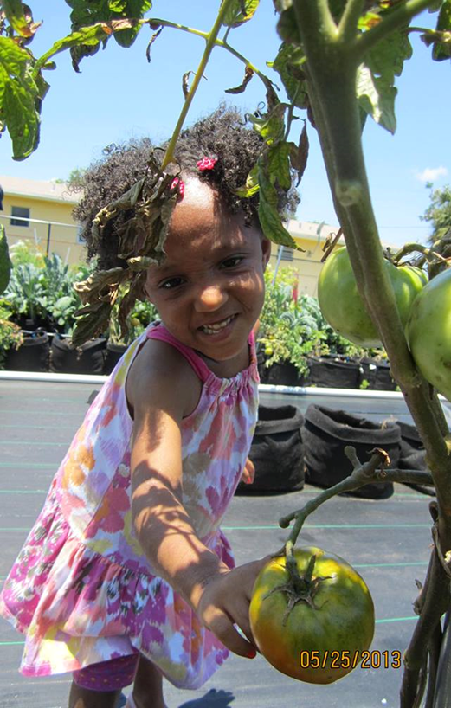
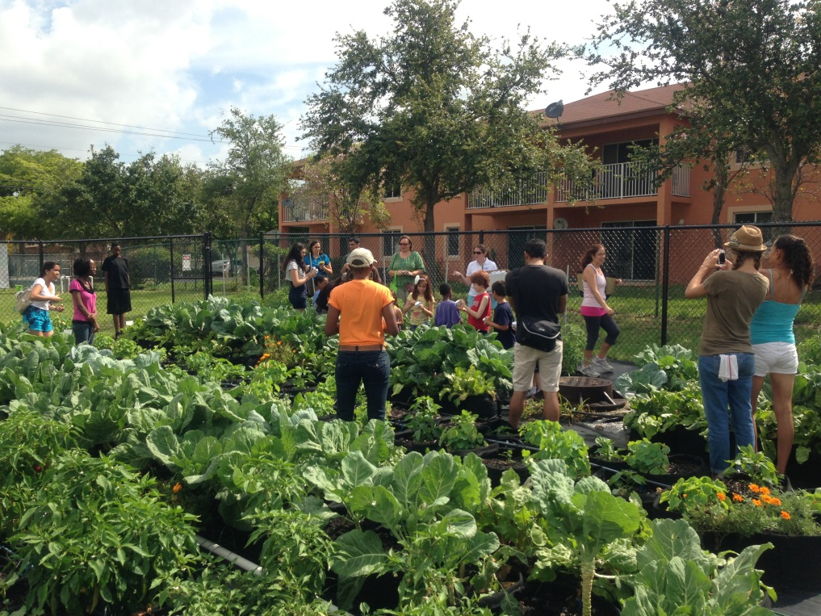

Slide 4
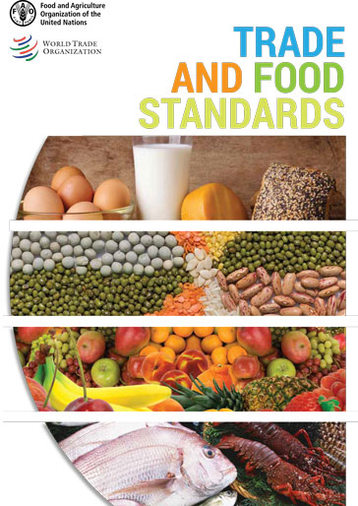


The Political Awakening of Food
“Food, like no other commodity, allows for a political reawakening, as it touches our lives in so many ways… Food citizenship suggests both belonging and participating, at all levels of relationships from the intimacy of breastfeeding to the discussions at the World Trade Organization.”
( Welsh & MacRae, 1998, p. 241)
Notes:
“Trade in Food Standards” emphasizes the importance of governments engaging in the setting of international standards for food (through the FAO/WHO Codex Alimentarius Commission) and in resolving food trade concerns through the WTO's relevant committees: the Committee on Sanitary and Phytosanitary Measures and the Technical Barriers to Trade Committee. The publication also underlines the importance of helping developing countries comply with international food standards so that they can participate more effectively in food trade.”
“Established by the United Nations Food and Agriculture Organization (FAO) and the World Health Organization (WHO) in 1963, the Codex Alimentarius, or “Food Code,” is the preeminent international food standards-setting body that protects the health of consumers and ensure fair practices in the food trade through the establishment of voluntary international standards, guidelines, and codes of practices.
U.S. Codex Program
The U.S. Codex Program is an interagency partnership that engages stakeholders in advancing science-based food standards to protect the health of consumers and ensure fair practices in the food trade.
Several federal agencies participate in the U.S. Codex Program through providing senior staff and executive delegates to represent the United States on many Codex committees, and the United States also chairs some committees. These Delegates to Codex committees (PDF, 352 KB) are primarily employed by regulatory agencies that set U.S. domestic food standards. Other U.S. agency officials participate in vital policy, coordination, and information dissemination activities relevant to their agency missions and interests.
As a statewide coalition, the Florida Breastfeeding Coalition is registered with the Centers for Disease Control and Prevention (CDC) and the United States Breastfeeding Committee (USBC) which allows the Coalition to participate in national training seminars and meetings to assist our state in legislative advocacy, minimizing barriers to breastfeeding, and supporting breastfeeding for healthy mothers and babies/children.
Baby-Friendly USA, Inc is the U.S. authority for the implementation of the Baby-Friendly Hospital Initiative (“BFHI”), a global program sponsored by the World Health Organization (WHO) and the United Nations Children’s Fund (UNICEF). The initiative encourages and recognizes hospitals and birthing centers that offer an optimal level of care for breastfeeding mothers and their babies. Based on the Ten Steps to Successful Breastfeeding, this prestigious international award recognizes birth facilities that offer breastfeeding mothers the information, confidence, and skills needed to successfully initiate and continue breastfeeding their babies.
There are more than 20,000 designated Baby-Friendly hospitals and birth centers worldwide. The “Baby-Friendly” designation is given after a rigorous on-site survey is completed. The award is maintained by continuing to practice the Ten Steps as demonstrated by quality processes.

Slide 5
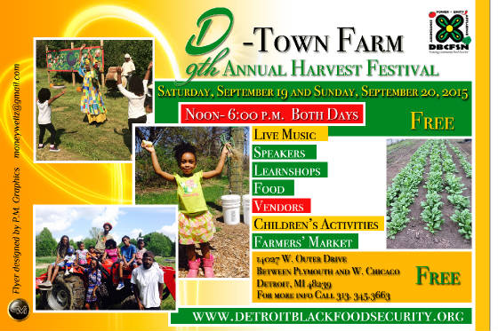
The Power of Food
“…The power of food lies in its material and symbolic functions of linking nature, human survival, health, culture and livelihood as a focus of resistance to corporate takeover of life itself.” (McMichael, 2000, p. 21)
Detroit Black Community Food Security Network’s vision is to advance movement towards food sovereignty while advocating for justice in the food system that ensures access to healthy foods with dignity and respect for all of Detroit’s residents.

Slide 6
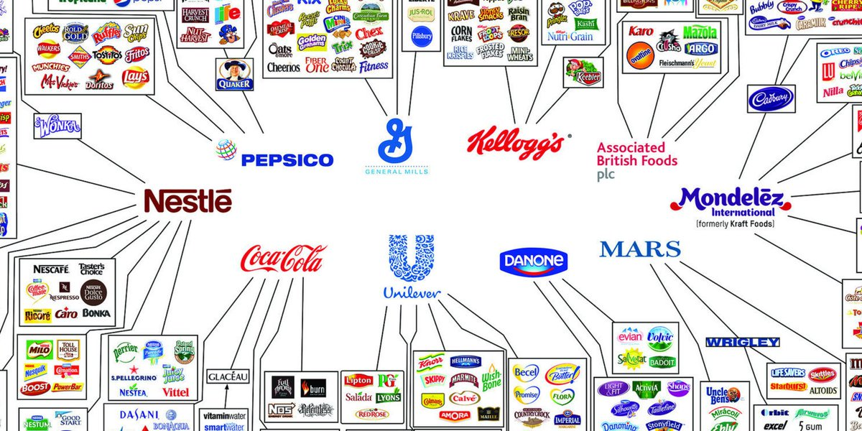
“Corporate takeover of life itself..”

Slide 7
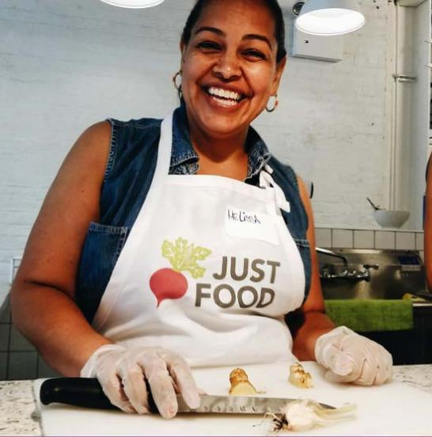

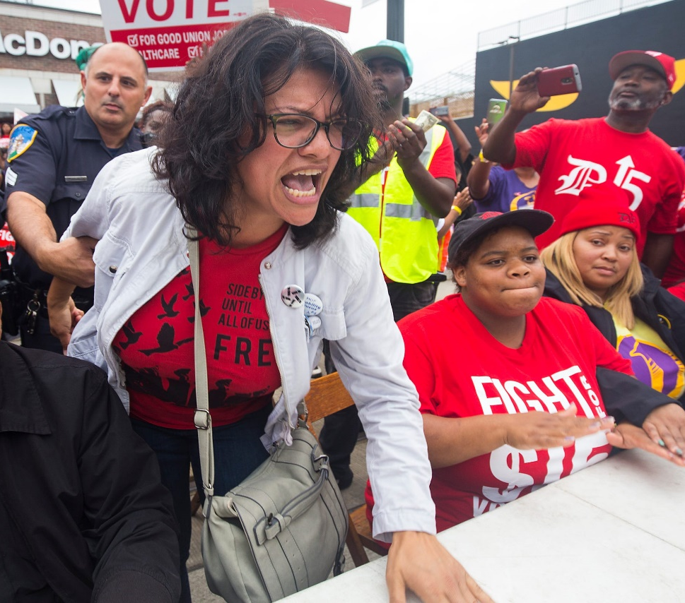
Food Justice
“Food Justice is communities exercising their right to grow, sell, and eat food that is fresh, nutritious, affordable, culturally appropriate, and grown locally with care for the well-being of the land, workers and animals. ”
Just Food, 2010, Quoted in Hope & Alkon (2011, p.5)
JUST FOOD
ENVISIONS A
SOVEREIGN AND
HEALTHY
FOOD SYSTEM
ROOTED IN
RACIAL,
SOCIAL,
ECONOMIC,
AND
ENVIRONMENTAL
JUSTICE.
“Rep. Rashida Tlaib, Michigan’s 13th congressional district, one of at least 20 demonstrators arrested during the “Fight for 15” rally, which drew hundreds of striking fast food cooks and cashiers, as well as activists and elected leaders.”-Huff Post, 10.2.18
www.justfood.org
Notes:
Food justice: Definition derived out of movements.
How do we obtain it in cities, where land is mostly privately owned?
Rashida made history in 2008 by becoming the first Muslim woman to ever serve in the Michigan Legislature.
Rashida Harbi Tlaib, U.S. Representative for Michigan's 13th congressional district since 2019. The district includes the western half of Detroit, along with several of its western suburbs and much of the Downriver area.

Slide 8
Food Sovereignty
FOOD SOVEREIGNTY
Food sovereignty is the right of peoples to healthy and culturally-appropriate food produced through ecologically sound and sustainable methods, and their right to define their own food and agriculture systems. It puts the aspirations and needs of those who produce, distribute and consume food at the heart of food systems and policies rather than the demands of markets and corporations.
-Declaration of Nyéléni, the first global forum on food sovereignty, Mali, 2007
What anchors this right?
How do we obtain it in a capitalist run society, which has a general policy of profit and externalized costs?
Notes:
Nyéléni is a village in Mali, Africa. It is located in Sélingué. The first International Food Sovereignty Forum took place in the village in February 2007.

Slide 9
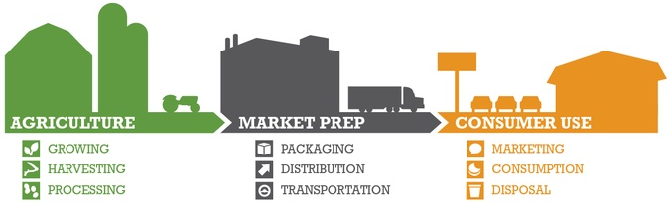
What is the Food System?
Graphic: http://www.charlestonorwig.com/
“The food system is the network of activities, actors, resources, regulations, and institutions required to produce, process, distribute, and dispose food.”-APA, 2008
Notes:
Raja, S., & American Planning Association. Planning Advisory Service. (2008). A planners guide to community and regional food planning : transforming food environments, facilitating healthy eating. Chicago, Ill.: American Planning Association.

Slide 10
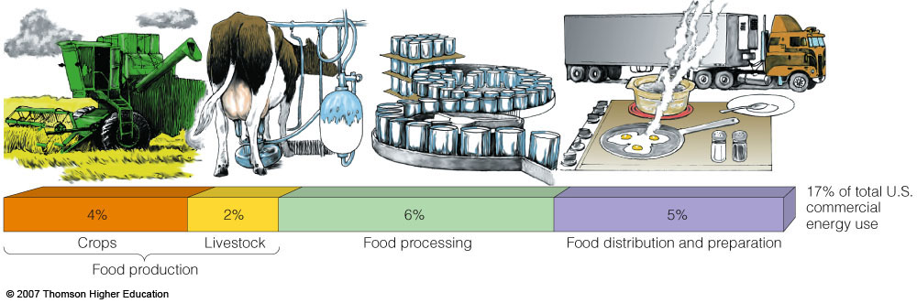
The Food System: Who is eating Whom?
17% of TOTAL U.S.
Commercial energy use
4%
2%
6%
5%
Industrial Food System: 10 units of Energy → 1 Calorie
About 400 gallons of oil per American for 3,600 calories of food.
About 20 minutes of labor to acquire food with oil.
Without Oil=3 Weeks of labor from each person.
Agroecology: 5 units of energy→100 units of food energy
(Giampietro & Pimentel, 1993; Shiva, 2005;, Pfeiffer, 2006; USDA ERS, 2017 )
Notes:
http://ecotope.org/people/ellis/papers/ellis_2010.pdf
Use of fossil fuels to produce the foods and beverages consumed by Americans in
2007 accounted for 13.6 percent of economywide CO2 emissions from fossil fuels.
Domestic fossil fuel use linked to U.S. food consumption produced 817 million of the
nearly 6 billion metric tons of CO2 emissions economywide from fossil fuels in 2007.
This disproportionate total is attributed to the food system’s above-average reliance on
fossil fuel energy sources. Whereas 86 percent of nationwide energy consumption in
2007 came from fossil fuels, the share of U.S. food-system energy from fossil fuels was
93 percent.

Slide 11
Food System Enviro-Bio Impacts
40-50% of the Earth‘s land surface manipulated for agricultural production.
13%-20% of global greenhouse gases from the food system.
Average of 4.2 million acres of Amazonian rainforest are cleared a year for commodities like soybeans and beef.
85% of U.S. fresh water consumption.
2 million acres of U.S. top soil eroded each year (3,125 ) square miles.
Genetic Erosion: Only 150 out 7,000 edible plant species considered commercially viable = 60% of our calories. (Thrupp, 2000, p. 269)
(Berry, 1986; Shiva, 2000; Pfeiffer, 2006; Pimentel et al., 2008; Steel, 2009)
Notes:
http://ecotope.org/people/ellis/papers/ellis_2010.pdf
Ellis et al. (2010) found that by 2000, 55% of Earth’s ice-free (not simply habitable) land had been converted into cropland, pasture, and urban areas. This left only 45% as ‘natural’ or ‘semi-natural’ land.
Anthropogenic transformation of the
biomes, 1700 to 2000
Erle C. Ellis1
*, Kees Klein Goldewijk2
, Stefan Siebert3
, Deborah Lightman4
and Navin Ramankutty

Slide 12
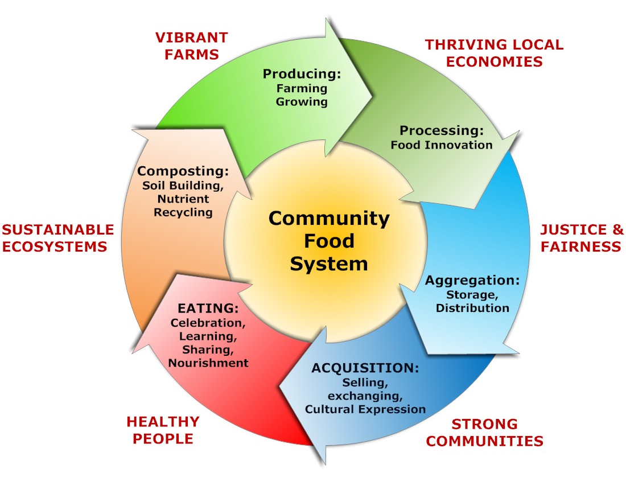
What is a Community Food System?
“The integration of sustainable food production, processing, distribution and consumption to enhance the environmental, economic, and social and nutritional health of a particular place. ”
Feenstra (2001, p. 100) and Garrett (1999, p. 2)
Graphic: Adapted from the CS Mott Group at Michigan State University

Slide 13
LAND Anchors Food Policy!
Land use refers to the relationship between people and how…
..the physical world is adapted, modified, or put to use for human purposes.
Land
Policy
Understanding the Basics of LAND USE AND PLANNING: Glossary of Land Use and Planning Terms (2010)

Slide 14
FOOD IS MULTISYSTEMIC
Food
System Change
Community Planning
Policies
Food Citizen Activism
“While food is an important part of the food system, it is only one part of a system that is directly and indirectly connected to other systems, like water, transportation, land use, energy, and economic systems.”
From Hodgson, 2012: https://www.planning.org/research/foodaccess/pdf/foodaccessreport.pdf
Notes:
The Food System is Intertwined with
Public Health
Dietetics and Nutrition
Environment, ecology, ecosystem
Social Welfare
General Economy
Challenged by
Climate
Population
Resources
Poverty and resultant Food Insecurity
Ordinances, statues, regulations and policies designed to work for one component
Invariably have impacts on another
Can cross geographic/political boundaries
Can cross local/regional food system “boundaries”
We tend to:
Work in our own special silos
Focus on those to which we are closest
Focus/work on/support/criticize etc. those we know and understand
When in reality:
we need to understand how all are interrelated
understand which support our/others’ interests
understand which go against our/others’ interests
understand the impacts of each across many disciplines and boundaries
We must identify:
Those that are good
Those that are questionable
Those that are bad – for one or more system components

Slide 15
Land Use Policy Documents

Slide 16
The Comprehensive Plan & Elements
A comprehensive plan is a statement of vison, policy and intent about the future growth and development of the community.
Vision developed through a community-wide planning process.
Adopted into law by some form of local government.
Used by community leaders to guide policies and decisions regarding a community’s physical and economic development.
Typical “Elements” found in Comprehensive Plans, which are systems interacting with the food system:
Land use (existing and future)
Housing
Infrastructure
Education
Recreation
Transportation
Duerksen & APA (2009)
Notes:
Also note that there are other plans: Master plans for parks, transportation, downtown development areas. All these planning documents are opportunities for including food-health related issues into the built environment.

Slide 17
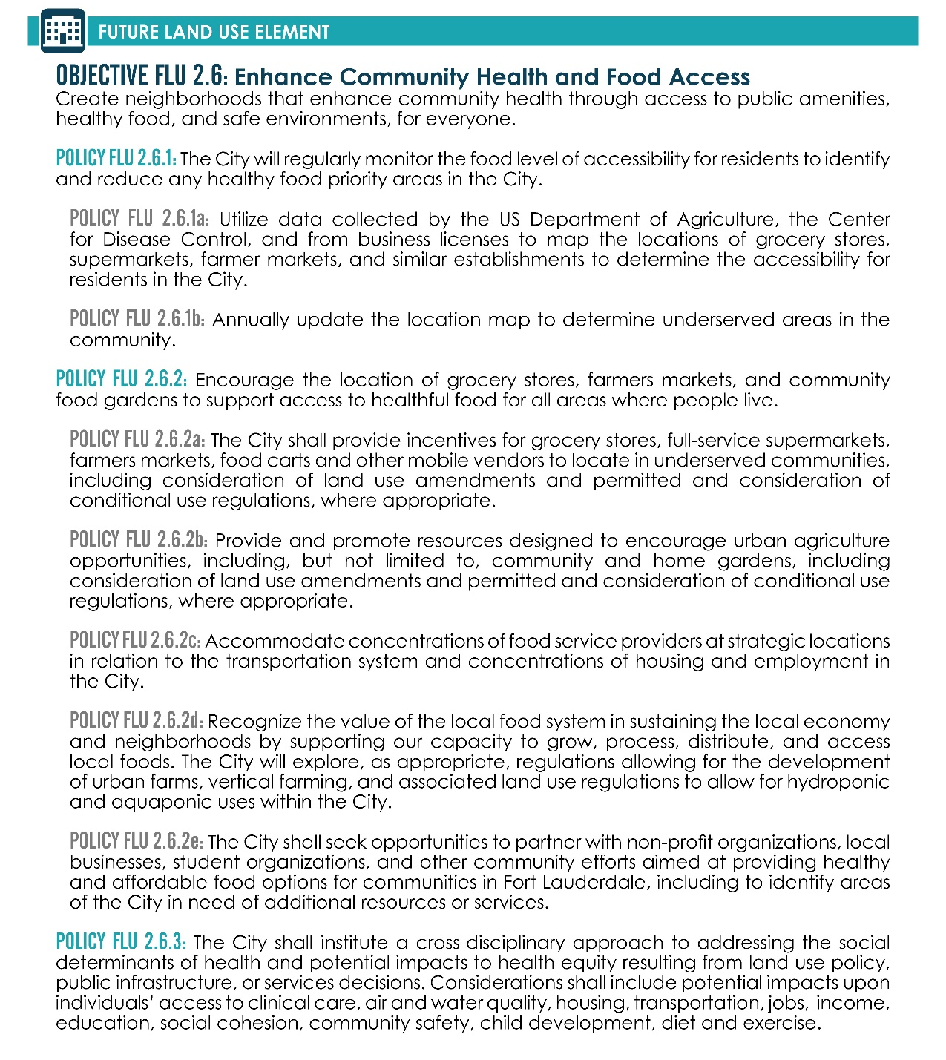
Fort Lauderdale Comp Plan Food Policies
Policy | Summary | Significance
POLICY FLU 2.6.1 POLICY FLU 2.6.1a POLICY FLU 2.6.1b | The City will regularly monitor the food level of accessibility for residents to identify and reduce any healthy food priority areas in the City. (a)Utilize data collected by the US Department of Agriculture, the Center for Disease Control, and from business licenses to map the locations of grocery stores, supermarkets, farmer markets, and similar establishments to determine the accessibility for residents in the City. (b) Annually update the location map to determine underserved areas in the community. | This series of policies directly addresses food access, particularly those in low access areas. Originally, this policy used to the term “food desert.” The Food for All Initiative advised that “food desert” was objectifying for low-income communities, and depended too much on supermarkets as a food access infrastructure. Therefore, the City adopted the term, “Food Access Opportunity Areas”, which is also promoted by the Center for a Livable Future. Nonetheless, the most significant idea in these policies is the geographic tracking of food accessibility using multiple data sources, for the explicit purpose of increasing food accessibility for residents who may live in low-access areas.

Slide 18
The Florida Community Planning Act: 163.3161
It is the intent of this act that local governments have the ability to preserve and enhance:
Present advantages
Encourage the most appropriate use of land, water resources, consistent with the public interest.
Overcome present handicaps
Deal effectively with future problems that may result from the use and development of land within their jurisdictions.
Through the process of comprehensive planning, it is intended that units of local government can preserve, promote, protect, and improve:
Public health, safety, comfort, good order, appearance, convenience, general welfare; facilitate the adequate and efficient provision of transportation, water, sewerage, schools, parks, recreational facilities, housing, and other requirements and services; and conserve, develop, utilize, and protect natural resources within their jurisdictions.

Slide 19
A Model for Food Sovereignty Activation
Mobilize around Land Use Food Policy Change
Local, Collective Participation
Adopted Land Use Regulations towards greater Food Sovereignty
GOAL:
Get food rights in:
Comprehensive Plans
Master Plans
Land Use Codes

Slide 20
Land Use Policy Strategy Discussion
Community Planning Elements
 | OPEN SPACE | SCHOOLS | Transportation | Housing | Buildings and infrastructure
Production | Policy ideas
Processing
Storage & Distribution
ACQUISITION
EATING & LEARNING
FOOD RENEWAL
Food system components
Notes:
WORKSHEET- Policy Matrix: You also have a worksheet (point to it on the Powerpoint) Going up and down are parts of the food system. Going across the top are common elements of a community plan. The objective of this activity is for you to combine at least one community plan element, with your assigned Food System Elements. Each of your groups is assigned TWO related Food System Elements. This is because we want you to think about how to connect strategies that work along the food system path. For example, if you are in Group 2, you have Processing & Acquisition or “Selling.” So, your task is to think about how are you going to increase our capacity for local processing and how to get locally made products to market…Processing is another term for food transformation. Think of turning strawberries into jam as an example of processing. While thinking of processing, you also have to think of Group 1’s area Production and Distribution, right? For example, say if we have a bunch of urban farms producing strawberries throughout the county. How are those urban farmers going to get those strawberries from the patch to the markets or your processing locations to transform strawberries into jelly and jam? What facilities are needed and where are they needed?? Would you place processing and retail near urban farms or within urban farms to reduce distribution and processing costs? What about the selling of the strawberries and jam? What do you need to actually get people to acquire this product via wholesale, retail, or even free? Now Look at the Community Plan elements. How can you use those to help you build local processing capacity to make more local jelly? So, for Housing, say if we had a strategy where we use the kitchens in dense residential areas to make urban farm jam? Say if we also have a program in those housing developments to bring the jelly to market. That is possible under the Florida Cottage Industry law. People can process strawberries into jam and sell it. How can we use that law as a resource to synergize locally-made products like strawberry jelly?”

Slide 21
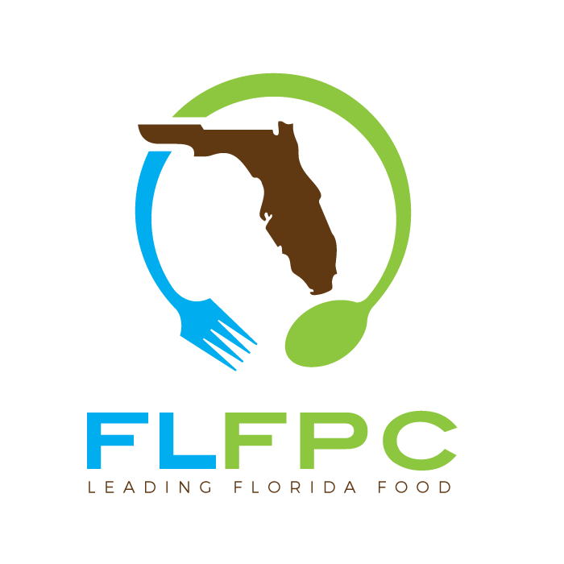
Thank you!
Anthony Olivieri
anthony.o@flfpc.org
https://flfpc.wildapricot.org/

